Slide 1
Major Tasks in Data Preprocessing
Change variable types
Data cleaning
  Resolve inconsistencies
  Deal with outliers
  Deal with missing values
Data reduction
  Combine variables to reduce data volume
  Use sample data
Important!
1. Carefully document all pre-processing steps
2. Retain original and transformed data

Slide 2
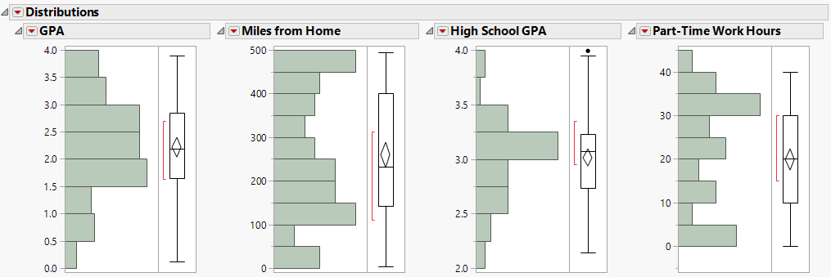
Outlier Detection (freshmen.jmp)
Outlier Box Plots are a useful tool to check for outliers in each variable
Points that lie outside the ‘whiskers’ are potential outliers

Slide 3
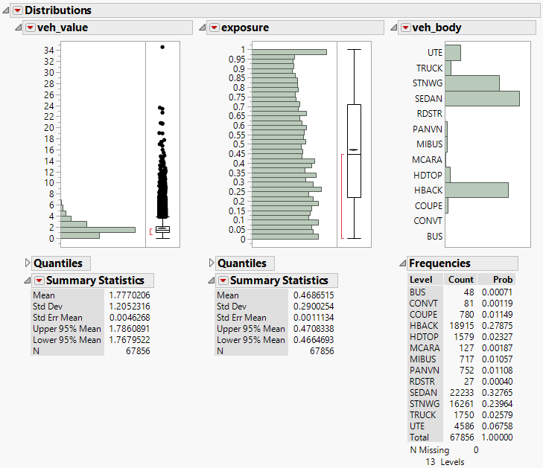
Outlier Detection (car.jmp)

Slide 4
What to do with outliers?
Leave them alone
Delete rows
Recode (in JMP, choose Cols, Recode)
Transform variables

Slide 5
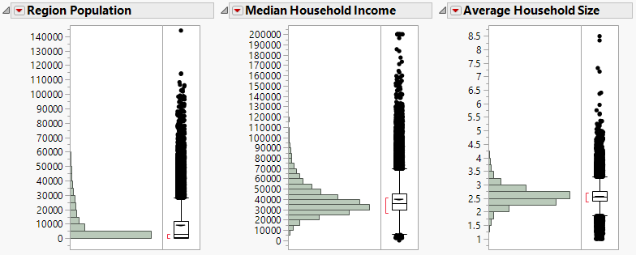
Extreme Values (Census 2000.jmp)
Some regions have very high household incomes – this causes income spread to be very high

Slide 6
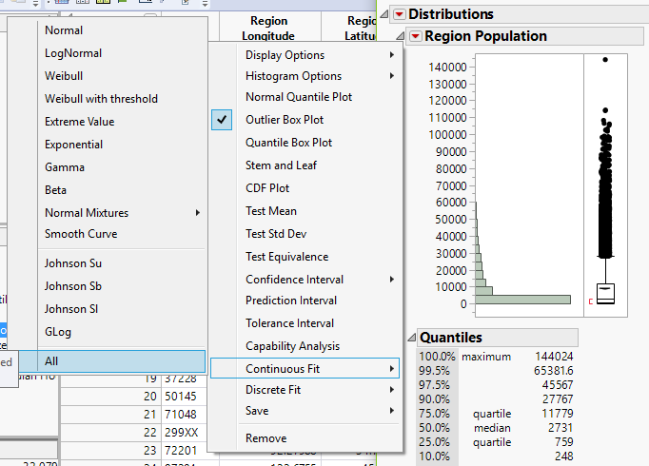
Variable Transformation
Find the best fit for the distribution

Slide 7
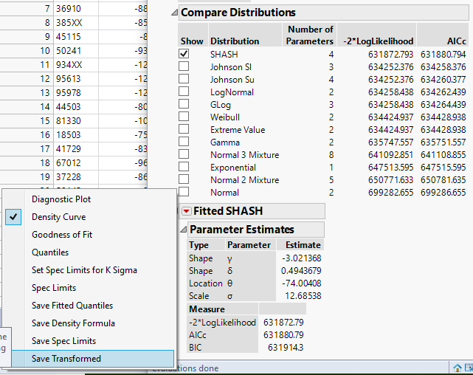
Create Transformed Variable
Possible Distributions sorted by AIC – lower is better. (AIC is a measure of fit.) Save the transformed variable. Check the formula to create the new variable.
(SHASH = sinh-arcsinh distribution)

Slide 8
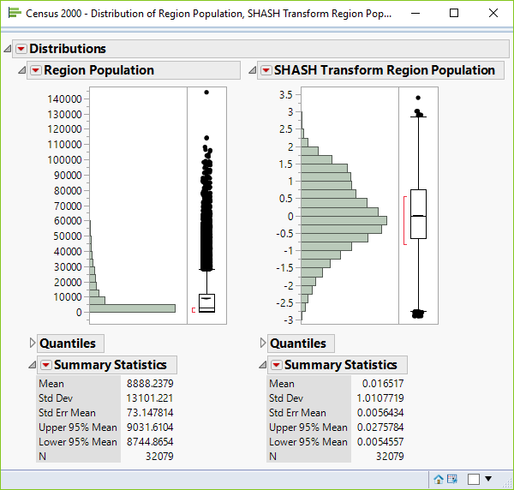
Old and New Distributions

Slide 9
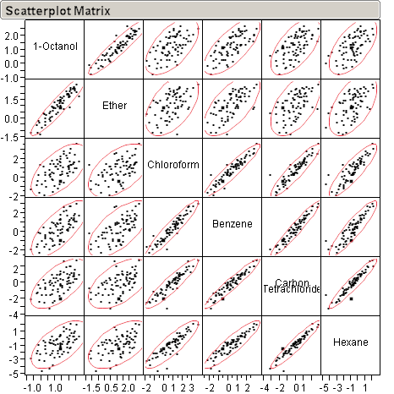
Outlier Detection (solubility.jmp)
Data points that are outside of the ‘structure’ of the data are also potential outliers
In JMP, choose
Analyze,
Multivariate Methods, Multivariate
Data points that are outside of the ‘structure’ of the data are also potential outliers

Slide 10
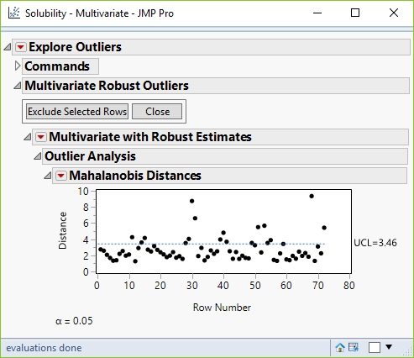
More Robust Outlier Detection

Slide 11
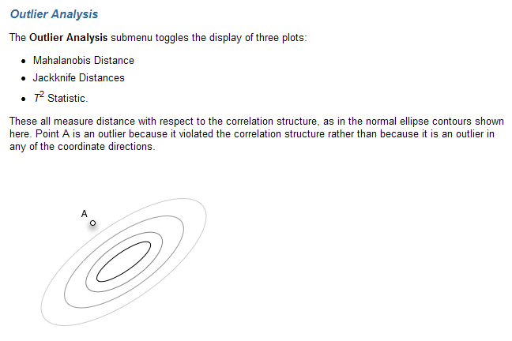
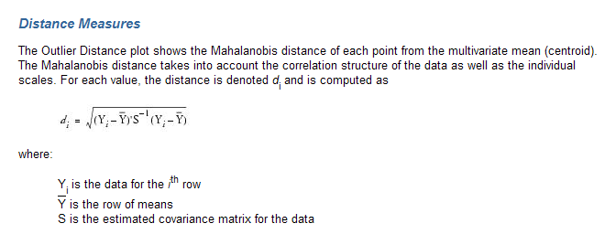
Details….

Slide 12
Missing Data Handling
Data is not always available, e.g., no recorded value for attributes such as customer income in sales data
Handling missing data
  Ignore the record: if number of records (such as 5%) with missing value is small
    Sometimes could be problematic with large number of variables,: 30 variables with 5% values missing, we would eliminate almost 80% of the data
  Fill in with
    a global constant : e.g., “unknown”, a new class?!
    the attribute mean
    the most probable value: inference-based such as Bayesian formula or decision tree

Slide 13
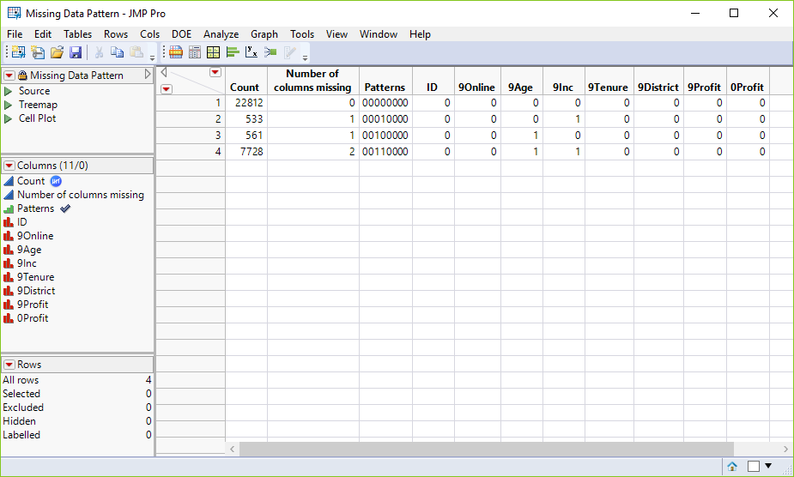
Missing Data in JMP
Pilgrim Bank.jmp
Choose Tables, Missing Data Pattern

Slide 14
What to do with missing values?
Nothing
Delete rows
Impute
  In JMP, Cols> Modeling Utilities> Explore Missing Values (Multivariate Normal Imputation - works only with numeric and ordinal data)
  Don’t impute what you want to predict

Slide 15
Data Reduction
Too many rows
  Computational Burden
  Choose a sample
Too many variables
  Redundant information
  Curse of dimensionality
  Model complexity

Slide 16
Reducing the number of variables
Curse of dimensionality
Model complexity
Redundant information

Slide 17
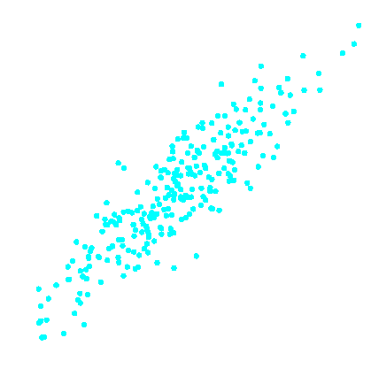




Redundant information
Redundancy
Irrelevancy
x₂
x₄
0.70
Input x₂ has the same information as input x₁.
0.60
0.50
0.40
x₁
x₃

Slide 18
The Curse of Dimensionality
1–D
2–D
3–D

Slide 19
How Many Variables and How Much Data
Good rule of thumb:
  10 records for each predictor variable

Slide 20
Model Complexity
Too many variables ➔ Model too complex ➔ does not work well on new data sets
Too complex
Not complex enough
Too few variables ➔ not enough predictive power

Slide 21
Reducing Categories
A single categorical variable with m categories is can be transformed into m-1 dummy variables (typically done behind the scenes in JMP)
Each dummy variable takes the values 0 or 1
  0 = “no” for the category
  1 = “yes”
Problem: Can end up with too many variables
Solution: Reduce by combining categories that are close to each other
Use tabulations to assess outcome variable sensitivity to the dummies

Slide 22
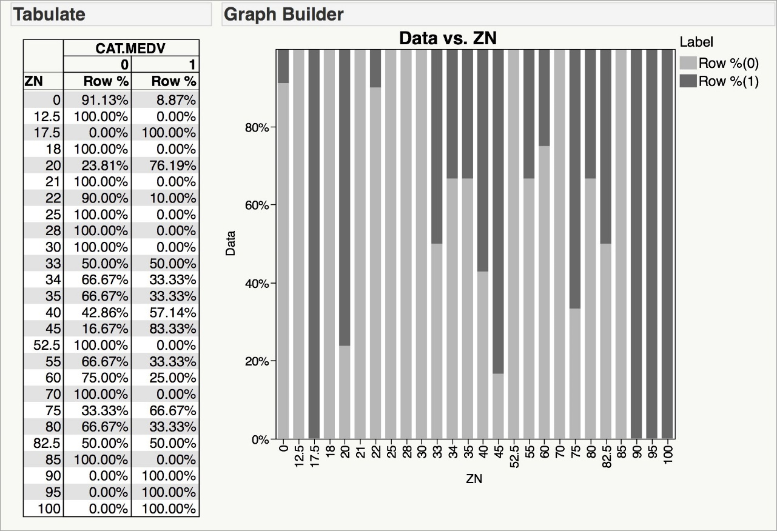
Combining Categories
Boston Housing Example: Many zoning categories are the same or similar with respect to CATMEDV.

Slide 23
Principal Components Analysis
Goal: Reduce a set of numerical variables.
The idea: Remove the overlap of information between these variable. [“Information” is measured by the sum of the variances of the variables.]
Final product: a smaller number of numerical variables that contain most of the information

Slide 24
Principle Component Analysis
How does PCA do this?
Create new variables that are linear combinations of the original variables (i.e., they are weighted averages of the original variables).
These linear combinations are uncorrelated (no information overlap), and only a few of them contain most of the original information.
The new variables are called principal components.

Slide 25
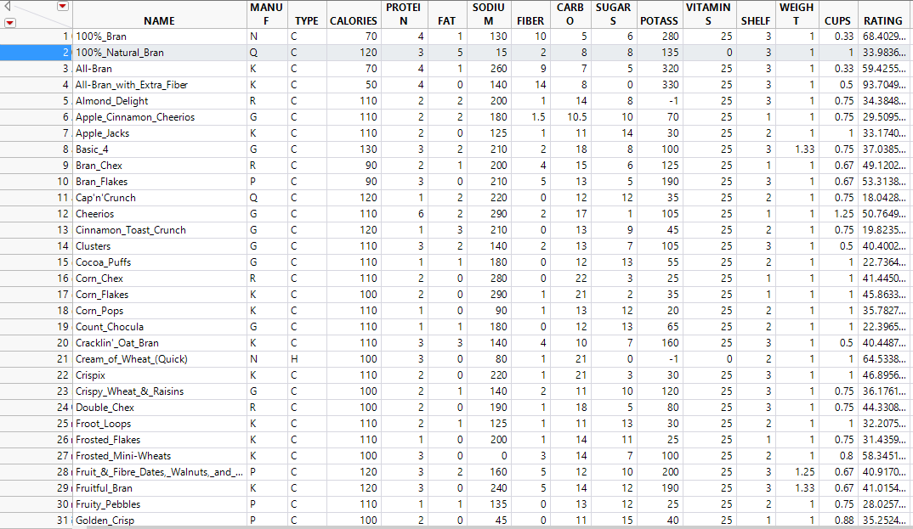
Example – cereals.jmp
13 variables describing cereals

Slide 26
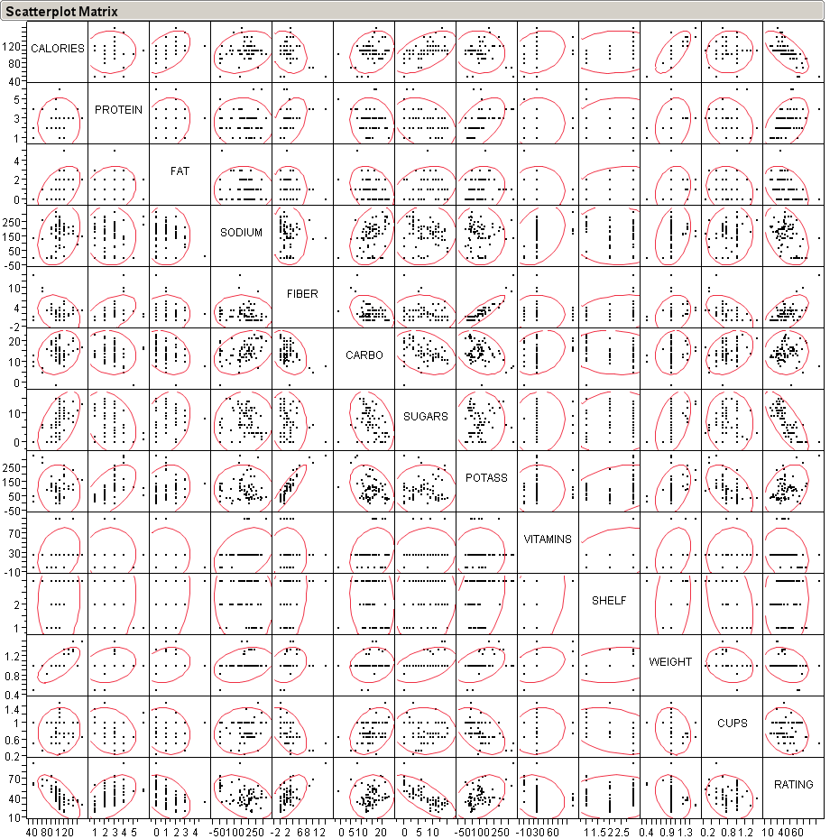
Consider Correlations
In JMP, choose Analyze, Multivariate Methods, Multivariate,

Slide 27
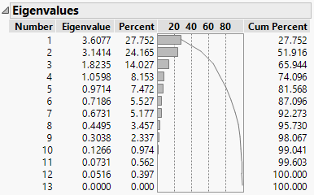
JMP – Choose Multivariate Methods, Principal Components
The first three principal components account for over 65% of total variance
The principal components are uncorrelated.

Slide 28
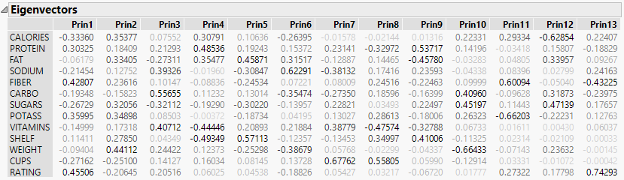
Principal Components
Look at Eigenvectors to see what variables go into each Principal Component.

Slide 29
How Many Components to Extract?
The Proportion of Variance Explained Criterion
  Step 1: specify how much variability to keep
  Step 2: keep the number of components reflecting this variability
5 Components explain 81% of variance
8 Components explain 96% of variance

Slide 30
PCA in Classification/Prediction
Apply PCA to training data
Decide how many PC’s to use
Use variable weights in those PC’s with validation/new data
This creates a new reduced set of predictors in validation/new data
28

Slide 31
Practice (solubility.jmp)
How many components would you extract?
Plot the first two principal components to see if they are correlated.
What is the formula for the first principal component?

Slide 32
Sampling
When the number of data points is too large
When variables of interest are too infrequent in the data set
  example – delinquency rates in Credit Scoring

Slide 33
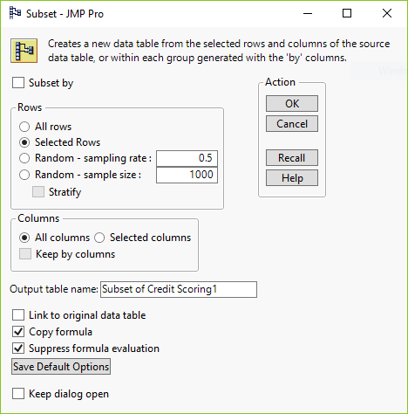
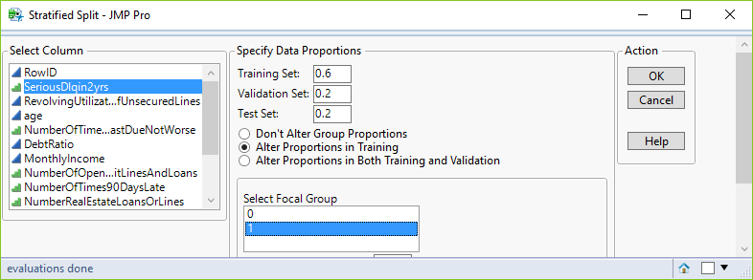
Stratified Sampling – Credit Scoring1.jmp
Create balanced training and validation samples.
Create proportional test sample.
Choose Tables, Subset to split 0’s and 1’s on SeriousDlqin2yrs.
Or use Stratified Split Balanced Add-In.

Slide 34
“Data Nightmares”

Slide 35
What Can Go Wrong with Data?
A few (of the many) things are:
  Unit errors:
    just because you have numbers doesn’t mean they are right
  Placement errors:
    ages of oldest/youngest drivers reversed on data entry
  Legitimate anomalies:
    Age of college student could be 14
  Missing data values:
    Explicit – e.g., coded in SAS as “.”
    Implicit/disguised – NoHit/NoScore IFS coded as 0/9999
Useful advice – don’t forget Murphy:
  “Anything that can go wrong will go wrong”

Slide 36
A Good Place to Start
Build a spreadsheet-like summary:
  Variable name
  Number of unique values it exhibits
  Most frequently occurring value
  % records listing that value
  % missing values (e.g., “.”, “NA”, “”)
Look through this summary for:
  Important variable names
  Variables with 1 level (completely useless)
  Variables that are almost constant or almost all missing (useless?)
  Surprises (e.g., multiple variables with almost the same name)

Slide 37
A Triage Strategy
Split the variables into three groups:
  Known to be important for analysis
  Known to be unimportant for analysis
  Others, to be examined further
Next, carefully examine the important variables to make sure they are what you think they are (e.g., examine plots, ranges, &c.)
Then, double check that the unimportant variables are unimportant
Finally, sort through the “others” to see what you might have missed in the first pass

Slide 38
Summary – avoiding “data nightmares”
  Key is to look carefully at the data before you use it
    Never assume it is what you think it is
  Practical issue: this is harder than it sounds
    Visualization is the best strategy for individual variables ...
    ... But you can’t look at everything ...
    ... This means you need simple pre-processing “triage” tools to help you decide what to look at
  Consequences:
    Data exploration & clean-up takes up to 80% of project time
    Post-analysis validation is critically important

